Slide 1
Session S: Lecture – SEM Trees
ATI Staff
Arizona State University
Summer 2016

Slide 2

Motivating Example

Slide 3
Goal of Analysis
To find clinically meaningful sub groups of non-suicidal self-injury (NSSI)
Cutoffs for DSM-V Criteria
Current cutoff = 5 NSSI acts in past year
Workgroup for disorder stated this is an “arbitrary cutoff”
Have measure of how many times participants self-injured in last year
“Have you ever, intentionally or on purpose, hurt yourself in the following ways, without the intention of killing yourself?”
Outcome
One-factor Factor Analysis consisting of:
Suicidality
Emotion Dysregulation
Emotion reactivity
Borderline personality
Disordered eating
Anxiety
Depression
Impairment

Slide 4
Decision Trees for Groups

Slide 5
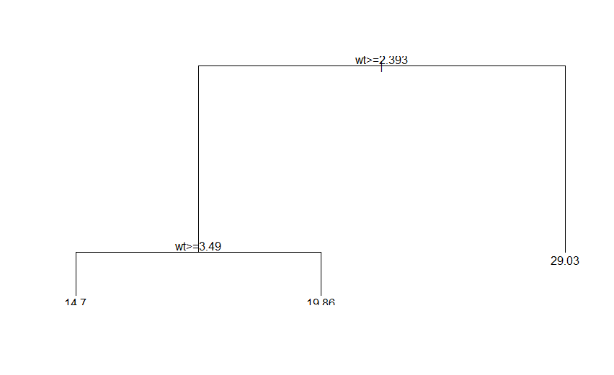
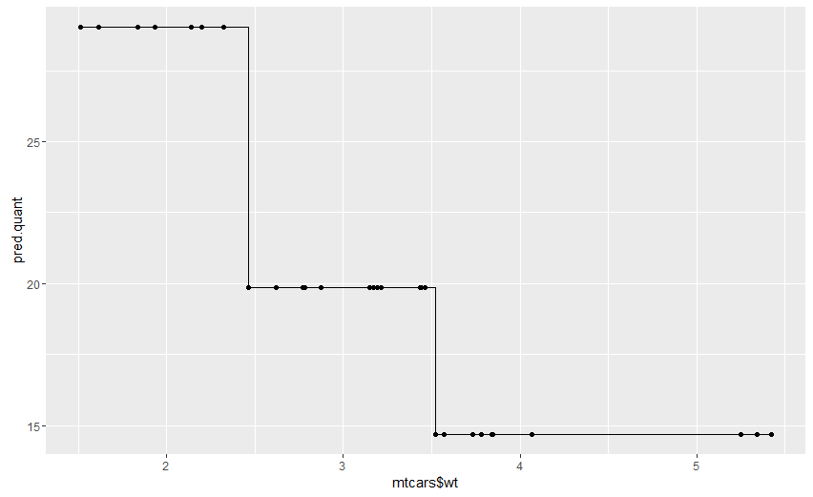
Decision Trees for Groups
As mentioned in previous presentations, Decision Trees (DTs) are non-linear models for predicting categorical or continuous outcomes
library(rpart);library(ggplot2); quant.out <- rpart(mpg ~ wt, data=mtcars); plot(quant.out);text(quant.out)
pred.quant <- predict(quant.out); qplot(mtcars$wt,pred.quant,geom=c("step","point"))

Slide 6
DTs for Groups Cont’d
Most applications in Data Mining don’t involve people
The stepwise prediction for DT applies to groups as well
Variable(s) you want to create groups with:
Predictor (one or more; categorical or continuous)
Categorical: Testing whether the levels of the variable are significantly different
Continuous: Looking for groups of people based on values of variable(s)
Variable(s) you care about relationship with groups
Outcomes (one or more; categorical or continuous)

Slide 7
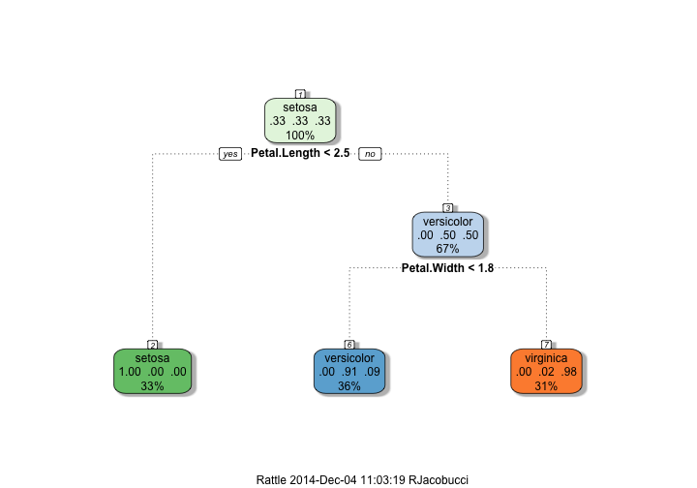
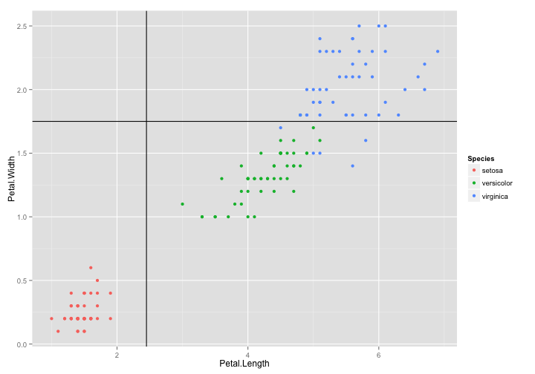
DT for Groups: Traditional Way
library(rpart);library(ggplot2);library(rattle);attach(iris)
fit2 <- rpart(Species ~ Petal.Length + Petal.Width, data = iris,control=rpart.control(maxdepth=2))
fancyRpartPlot(fit2)
p <- qplot(Petal.Length,Petal.Width,colour=Species); q <- p + geom_vline(xintercept=2.45)
q + geom_abline(intercept=1.75,slope=0)
Not people, but flowers!
Petals = Predictor

Slide 8
Now, instead of predicting group members, we are searching for groups within the predictors.

Slide 9
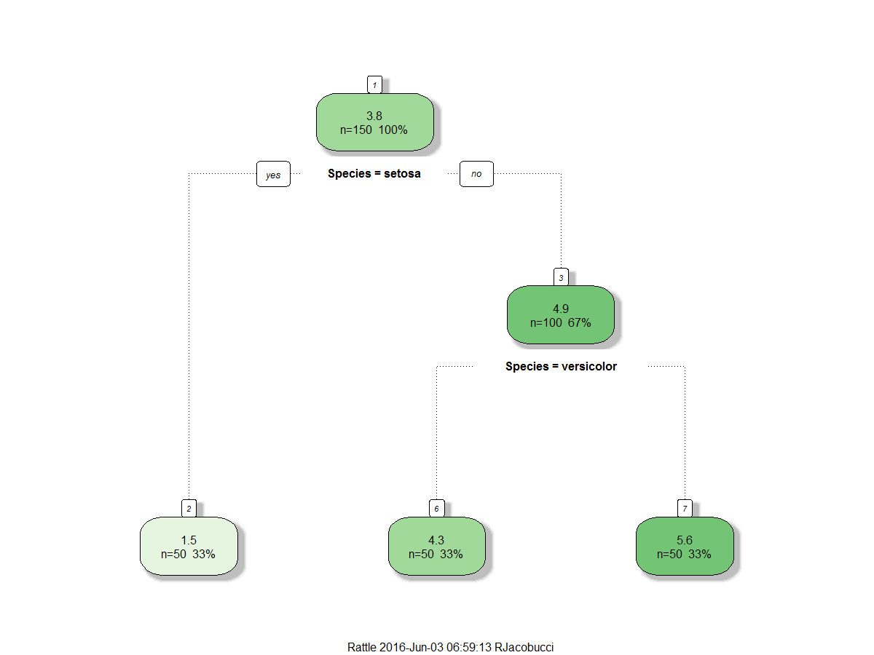
DT for Groups: Switch Predictors & Outcomes
library(rpart);library(ggplot2);library(rattle);attach(iris)
fit2 <- rpart(Petal.Length ~ Species, data = iris,control=rpart.control(maxdepth=2))
fancyRpartPlot(fit2)
Flower = Predictor
Test whether the groups are
significantly different

Slide 10
DT for Groups Cont’d
Many times we have variables that we might want to create subgroups based on
Income → find cutoffs for low, middle, high SES groups
Have continuous test scores and find cutoff for admission criteria
i.e. only accept those > 160 on GRE
Which group has biggest differences on outcome?
Gender or Ethnicity a more “important” grouping in relation to supporting Clinton or Trump?
Want to find interactions between groups to create further subgroupings
Females in low SES prefer Trump while females in high SES prefer Hillary
Often times limited by only using 1 variable as an outcome
Where multivariate DT methods come in
E.g. multivariate boosting or SEM Trees

Slide 11
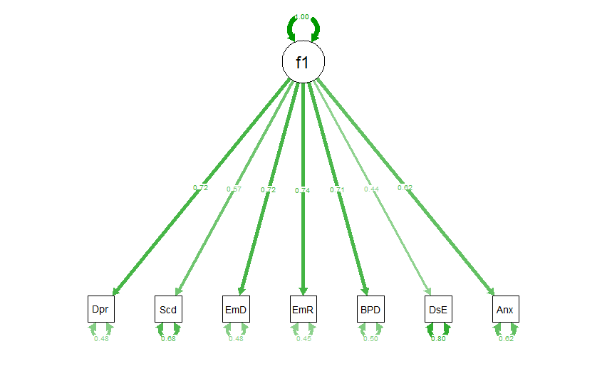
DTs and NSSI
We want to find subgroups of people based on the number of times they self-injures
In relation to:
A summed score
A factor score

Slide 12
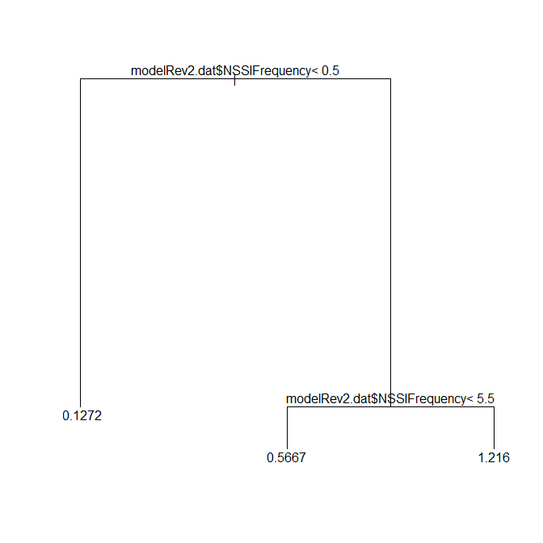
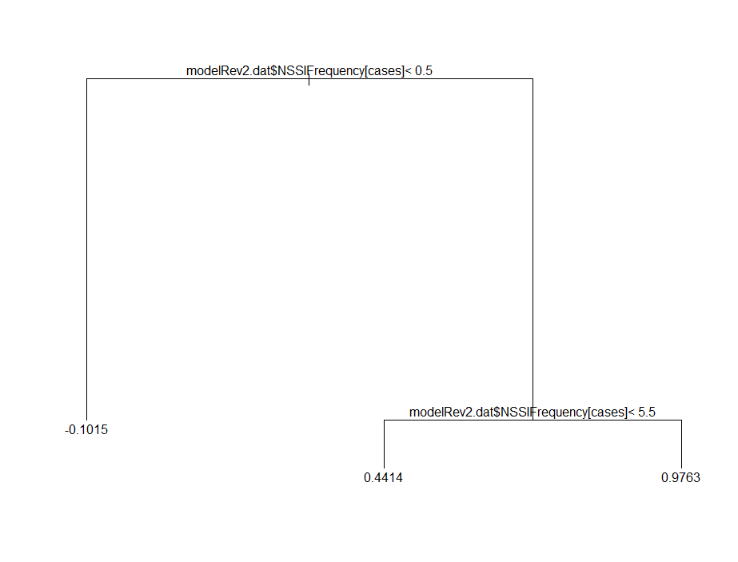
DTs and NSSI cont’d
NSSI Summed Score
NSSI Factor Score

Slide 13
So What Did We Learn?
Cutoffs for NSSI Frequency Criteria should be:
Between 0 & 1
Between 5 & 6
The DT results give us three groups with those cutoffs
But what does this actually mean?
People w/ NSSI value of 0 have a deviation between their actual and predicted factor score that is significantly smaller than between their actual scores and predictions for any other group, including assuming every is in one group
More technically, putting people into groups decreases the RMSEA

Slide 14
SEM Trees & NSSI

Slide 15
When We Can’t Reduce the Outcome to a Single Value
Need SEM Trees or other multivariate model (Multivariate Boosting or others)
Instead of reducing our outcome to a single variable we can use:
Means of multiple variables
A confirmatory factor model
Latent growth model
Autoregressive model
Etc.

Slide 16
SEM Trees
Outcome
Predictor
NSSI

Slide 17
SEM Tree Cont’d
Different than just including a covariate in the model
In SEM Trees, the covariates predict the model fit
Not just the latent variable
In predicting the fit of the model, you are indirectly predicting differences in each of the model parameters
i.e. factor variance, mean, loadings ….
In other words: If you change the model parameters then you change the model fit

Slide 18
SEM Trees Algorithm
In our NSSI example, the NSSI variable has integer values ranging from 0 to 1000
If a covariate is an integer in SEM Trees, the model tests groups at every value:
1. Fit of multiple group model with groups of people with values of 0 and 1-1000
Get model fit
1. Fit of multiple group model with groups of people with values of 0 or 1 and 2-1000
Get model fit

Slide 19
SEM Trees Algorithm Cont’d
People w/ NSSI = 0
At each tested split, the model becomes
All cases
+
VERSUS
People w/ NSSI > 0

Slide 20
SEM Trees Algorithm Cont’d
Fitting the SEM in each group results in a separate fit
LL (log-likelihood) for each model
Model parameters are now group specific
This can be compared using the likelihood ratio test
Is LL_{all} <* LL_{NSSI = 0} + LL_{NSSI = 1-1000}
* Fit will always be better in multiple group model, but about significance
Larger LL is better (less negative)
2 times the difference between models is a chi square distribution
Df = number of parameters of multiple group model minus parameters of no group model

Slide 21
SEM Trees Algorithm Cont’d
If the covariate is an integer (& ordinal), tests every possible group in sequence
0 vs. 1-1000, 0-1 vs 2-1000, 0-2 vs 3-1000 etc…
Same thing if numeric (continuous; i.e. 0.324)
Will test every value in sequence, so may be better to round first
If categorical (factor), one vs. the rest scheme
If 5 categories, 15 possible splits
Computationally intensive
Once a best split is determined:
Move down one level to start over searching for an additional split
Continues until:
No longer improves model fit
Reaches other stopping criterion
Too small N in a node
A priori set maximum depth (# of groups)

Slide 22
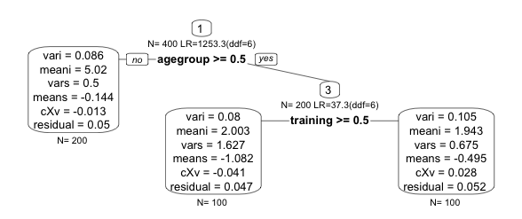
SEM Trees Algorithm Cont’d
Just like DT, SEM Trees can create a large tree
Say the first split is between 0 & 1
Next level, test splits on other variables
Example:
Second split occurs at agegroup = 1 &
between training 0-1
No further split for agegroup = 0

Slide 23
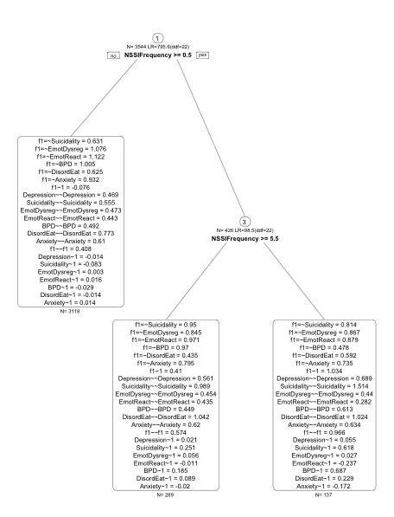
SEM Trees & NSSI
Use a one factor CFA as the outcome
Came up with the same splits as with DT

Slide 24
SEM Trees & NSSI Cont’d
Can investigate individual parameters to get a better clue to how groups differ
Factor mean increased w/ NSSI frequency
Most variable means increased
Factor variance increased

Slide 25
SEM Trees & NSSI Conclusion
Agreement in cutoffs across methods
Important, as SEM Trees hasn’t been studied that much
SEM Trees allows for a more comprehensive evaluation
While being able to make specific comparisons across groups
Was able to incorporate more information into the model than if we used mixture models
This is not always the case in comparing mixtures and SEM Trees
We had a very informative covariate
Not that difficult to program and didn’t take long to run
Demonstrated in Lab Session T

Slide 26
SEM Trees Options

Slide 27
SEM Trees Options
Because there is an SEM for each group
Should set minimum number of cases per node of tree
min.N in semtree.control
Large number of covariates?
Need to prevent type-1 errors (overfitting)
Also, large, uninterpretable tree
Can use Bonferroni correction or use cross-validation
bonferroni = TRUE or method=“cv” in semtree.control
Large number of response options for covariate(s)
These variables are more likely to be split on
Correct with changing method=“fair”

Slide 28
SEM Trees & Invariance
In many contexts, it is necessary to ensure that groups are measured on the same construct
This can either be call differential item functioning (IRT) or measurement invariance (SEM)
This entails constraining certain parameters to be equal across groups
Most common: constrain factor loadings
Easy to do in SEM Trees
Set invariance = parameter names in semtree.control
Demonstrated in Lab Session T

Slide 29
SEM Trees vs. Mixture Models

Slide 30
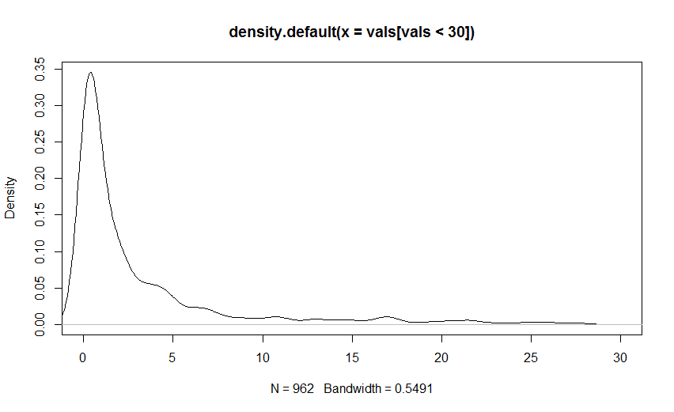
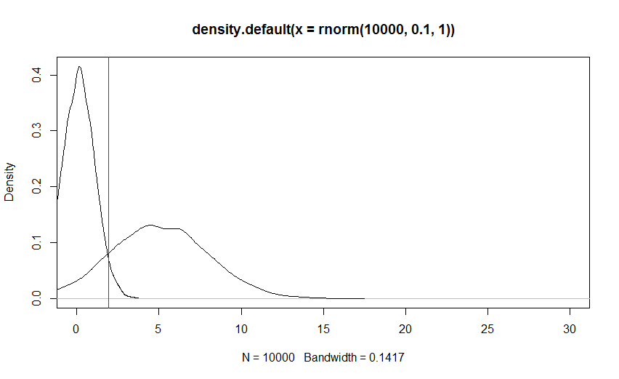
Mixture Models
Traditional way of doing things
Look for multiple underlying normal distributions underlying NSSI distribution
=
Notes:
There are other methods such as clustering

Slide 31
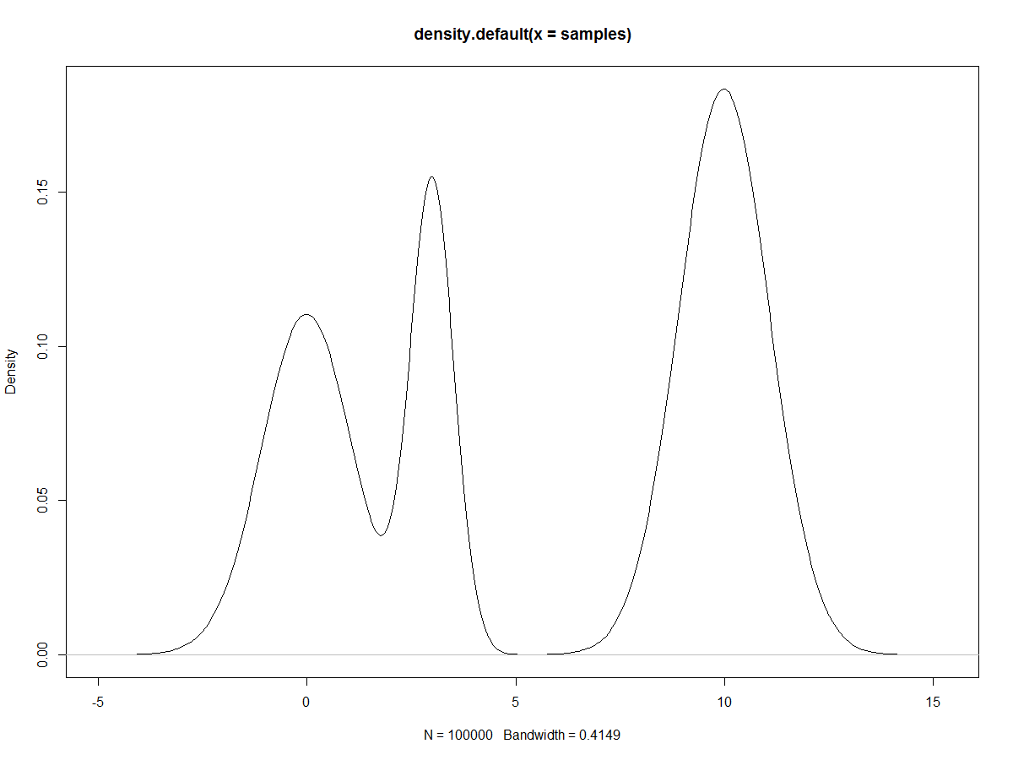
SEM Trees vs. Mixture Models
Do very similar things, but find groups (classes) a little differently
Let’s say we have a variable we are trying to find groups in
Hypothetical distribution for a cognitive score variable:

Slide 32
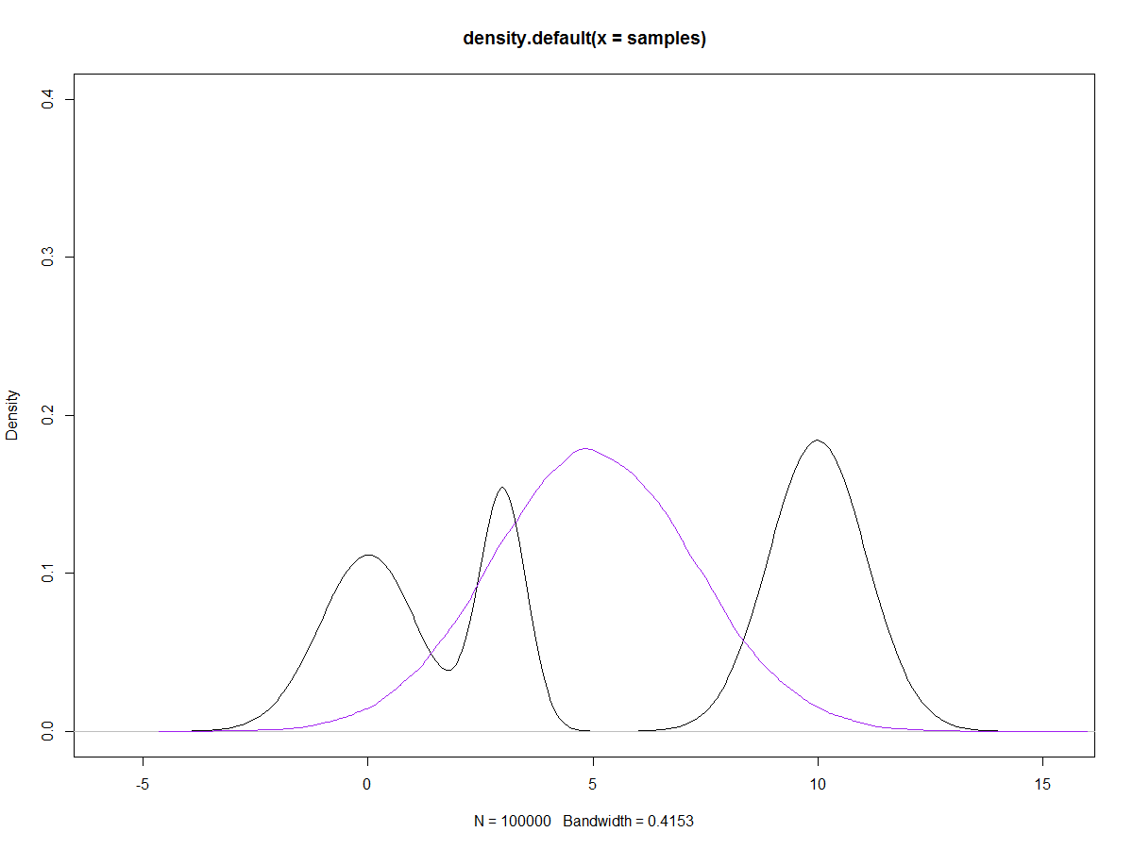
Assume Homogeneity
Doesn’t do so well

Slide 33
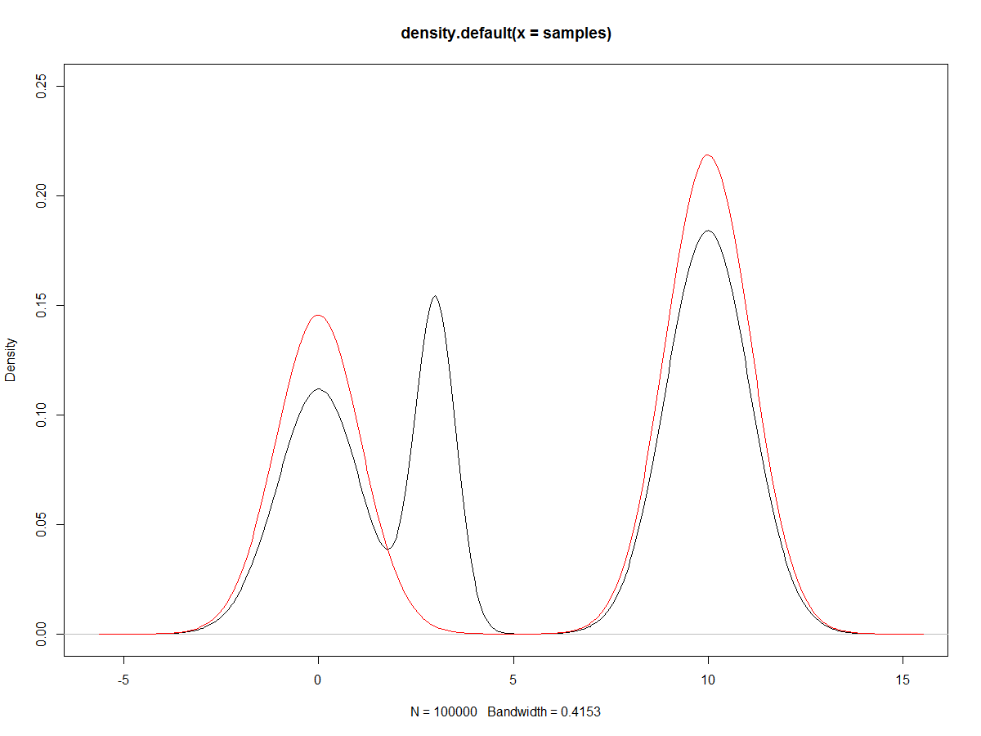
Comparison Example
Mixture models will attempt to fit this distribution directly
An example with 2 classes

Slide 34
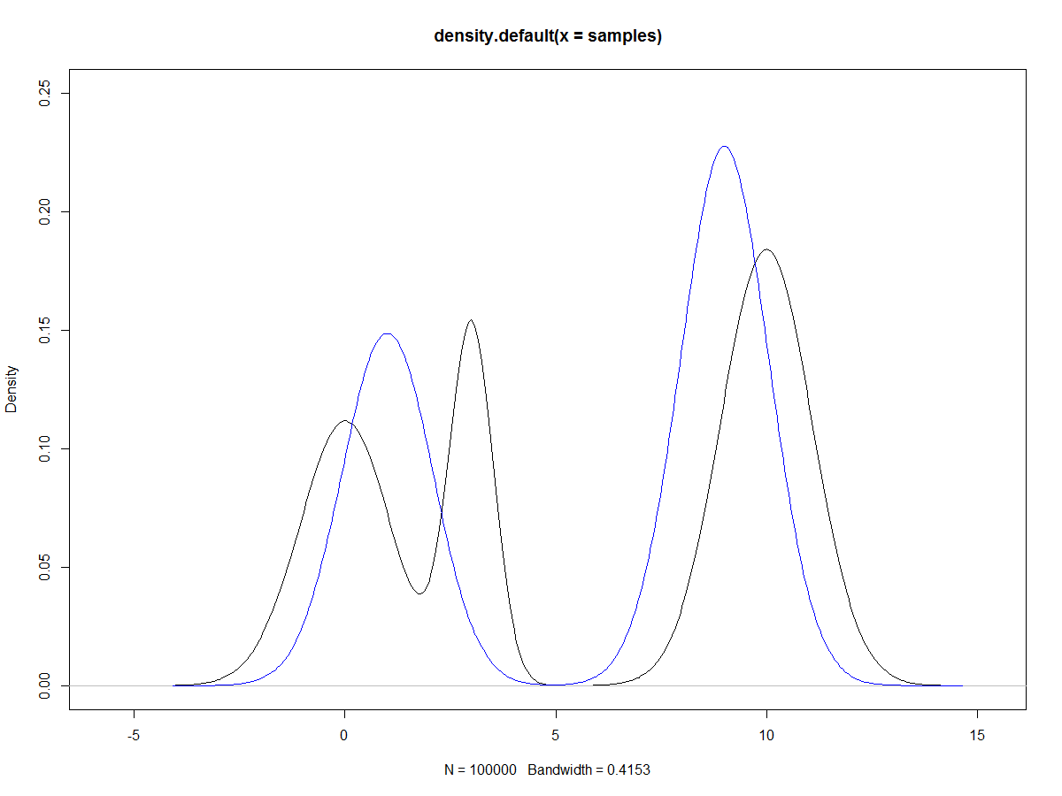
Comparison Example Cont’d
SEM Trees will try and fit this distribution
But only through splitting on the covariates
Meaning SEM Trees is more constrained
Doesn’t have access to the whole search space
For example, the blue line could represent the distribution for a gender variable

Slide 35
Comparison Example Summary
SEM Trees requires informative covariates to split on
Mixtures do not
SEM Trees may be less likely to overfit
SEM Trees allows interactions and non-linear prediction
In mixtures, the classes are all at the same level, not nested or based on interactions
In mixtures, the relationship between class membership and auxiliary variables is constrained to be linear
Can be very useful to test both methods and compare the resultant groups

Slide 36
SEM Tree vs. Growth Mixture Model

Slide 37
Comparison Example
Compare differences in trajectories
Using a latent growth curve model
Change in reading from Kindergarten to 8th grade
Early Childhood Longitudinal Study - Kindergarten Cohort (ECLS-K) data
Questions we are trying to answer
Do all children learn at the same rate or are the subgroups?
i.e. Late bloomers (start low, but catch up)
Those who start high and improve fast
Can other measured variables give us insight into these groups
Covariates include fine motor skills (fine), gross motor skills (gross), approaches to learning (learn), self-control (control), interpersonal skills (interp), internalizing behaviors (int), and general knowledge (gk1)

Slide 38
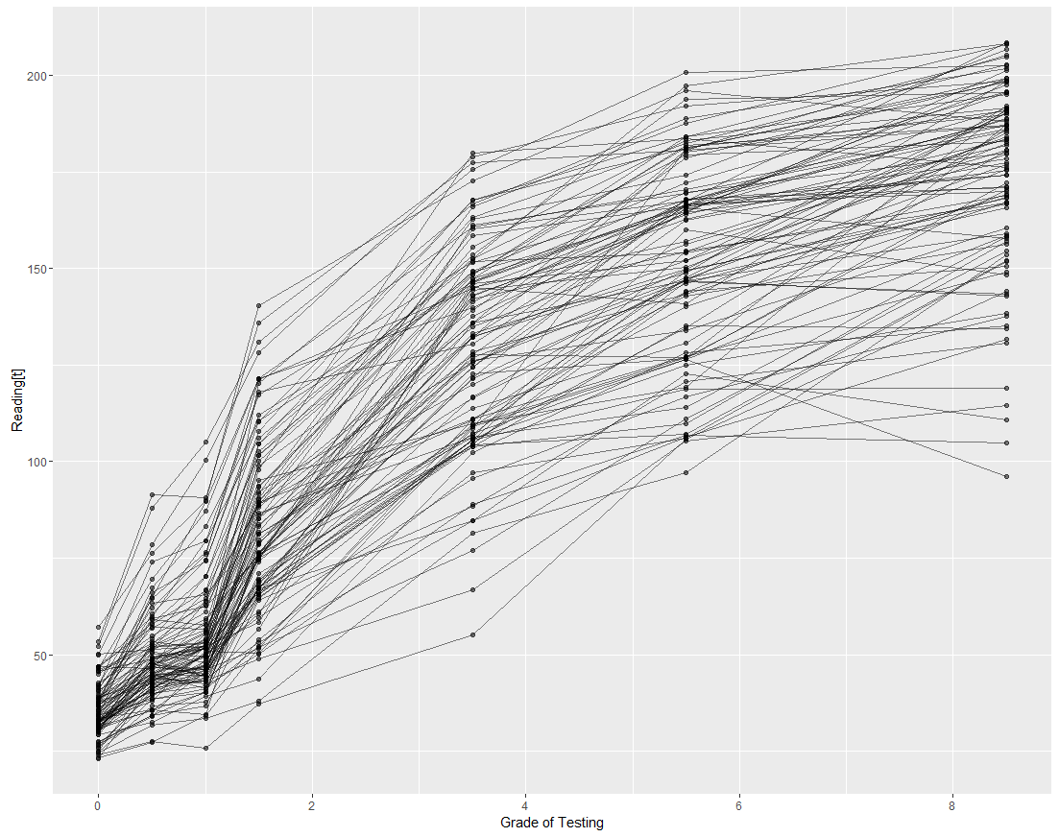
Trajectory Plot

Slide 39
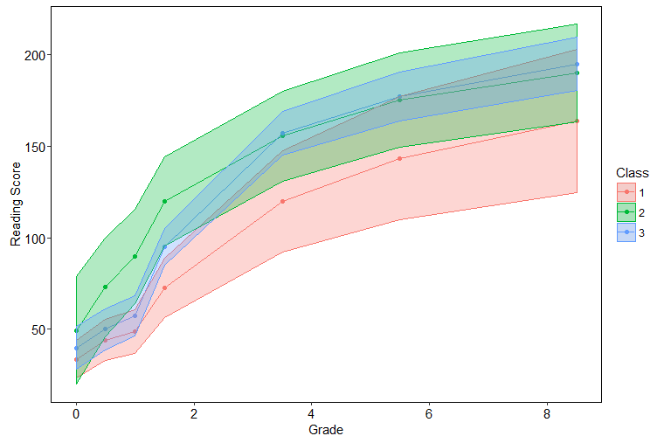
Growth Mixture Model

Slide 40
Growth SEM Trees

Slide 41
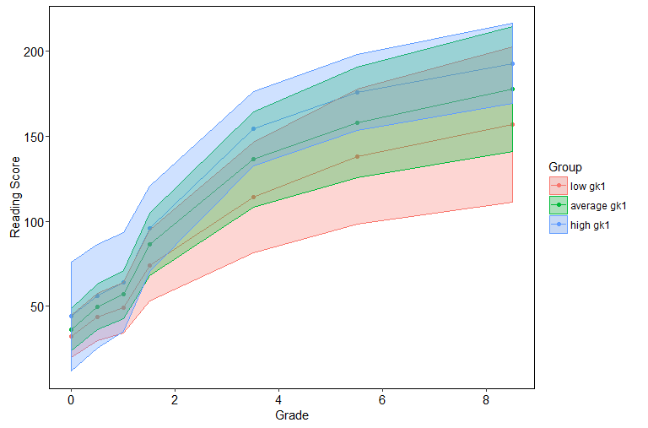
Growth SEM Trees

Slide 42
Comparison Example Summary
SEM Trees split twice on the general knowledge variable
Was a significant auxiliary variable in Mixture Model
SEM Trees didn’t fit as well
More variability within group and overlap across groups
The Growth Mixture Model had more interesting classes
Class 1 caught up to Class 3 in grades 4 and 5
Different loadings across groups
SEM Trees groups really only differed in Kindergarten

Slide 43
SEM Trees Conclusion
Has been extended to allow multiple trees
SEM Forests – analogous extension from DT → Random Forests
Can take a really long time to run (hours/days)
Very new method
Hasn’t been tested to a large extent to set guidelines for best practices
Can take a long time to run
Small model and small # of covariates can be 5 minutes
Large model and large # of covariates can be hours
REMEMBER: Just because you get out a tree, does not mean that it represents real groups
Needs to make theoretical sense
Could just be the product of overfitting

